Slide 1
Chapter 4 Static Test
Static investigations like reviews and tool-supported analysis of code and documents can be used very successfully for improving quality.
An often-underestimated examination method is the so called static test,often named static analysis. Tool supported static analysis is only possible for documents with a formal structure.
The goal of examination is to find defects and deviations from the existing specifications, standards to comply with, or even the project plan.
An additional benefit of the results of these examinations is optimizing the development process. The basic idea is defect prevention: defects and deviations should be recognized as early as possible before they have any

Slide 2
Chapter 4 Static Test
effect in the further development process where they would result in expensive rework.
Static investigations like reviews and tool-supported analysis of code and documents can be used very successfully for improving quality.
4.1 Structured Group Evaluations
4.1.1 Foundations
Reviews apply the human analytical capabilities to check and evaluate complex issues. Intensive reading and trying to understand the examined documents(codes) is the key.
There are different techniques for checking documents. They differ regarding the intensity, formality, necessary resources (staff and time), and goals.
4.1.2 Reviews

Slide 3
Chapter 4 Static Test
Review is a common generic term for all the different static analysis techniques. Another term, often used with the same meaning, is inspection. However, inspection is usually defined as a special, formal review using data collection and special rules.
All documents can be subjected to a review or an inspection and they are also called peer reviews.
In addition to defect reduction, reviews have further positive effects:
■ Cheaper defect elimination. If defects are found and eliminated early,productivity in development increases because fewer resources are needed for defect identification and elimination later. These resources can instead be used for development.

Slide 4
Chapter 4 Static Test
■ Shortened development time.
■ If defects are recognized and corrected early, costs and time needed for executing the dynamic tests (see chapter 5) decrease because there are fewer defects in the test object.
■ Because of the smaller number of defects, cost reduction can be expected during the whole product life. For example, a review may detect and clarify inconsistent and imprecise customer requests in the requirements.
■ During operation of the system, a reduced failure rate can be expected.
■ As the examinations are done using a team of people, reviews lead to mutual learning. People improve their working methods, and reviews will thus lead to enhanced quality of later products.

Slide 5
Chapter 4 Static Test
■ Because several persons are involved in a review, a clear and understandable description of the facts is required.
■ The whole team feels responsible for the quality of the examined object. The group will gain a common understanding of it.
The following problem can arise:The author may get into a psychologically difficult situation, feeling that he as
a person and not the document is subject to critical scrutiny.
The costs caused by reviews are estimated to be 10–15% of the development budget. If reviews are systematically used and efficiently run, more than 70% of the defects in a

Slide 6
Chapter 4 Static Test
document can be found and repaired before they are unknowingly inherited by the next work steps.
Documents with a formal structure should be analyzed using a (static analysis) tool that checks this structure before the review. The tool can examine many aspects and can detect defects or deviations that do not need to be checked in a review (see section 4.2).
The following factors are decisive for success when using reviews (as suggested by [IEEE 1028]):
■ Every review has a clear goal, which is formulated beforehand.
■ The “right” people are chosen as review participants based on the review objective as well as on their subject knowledge and skills.

Slide 7
Chapter 4 Static Test
4.1.3 The General Process
A review requires six work steps: planning, kick-off, individual preparation,review meeting, rework, and follow-up.
Planning:she makes sure that the document is in a reviewable state, i.e., it is complete enough and reasonably finished; If a kick-off meeting is necessary, the place and time must be agreed upon; leader(moderator),competent staff....
kick-off:The kick-off (or overview) serves to provide those involved in the review with all of the necessary information;The purpose is sharing information about the document to be reviewed (the review object);If the people involved are not familiar with the domain or application area of the review object, then a short introduction to the

Slide 8
Chapter 4 Static Test
material may be arranged; Review criteria (for example, checklists) are very useful for supporting a structured process;For more formal reviews, the entry criteria must be checked.
Individual Preparation:The members of the review team must prepare individually for the review meeting. A successful review meeting is only possible with adequate preparation;The reviewers intensively study the review object and check it against the documents given as a basis for it as well as against their own experience.They note deficiencies (even any potential defects), questions, or comments.
Review Meeting:A review leader or moderator leads the review meeting. Moderator and participants should behave diplomatically (not be aggressive with each other) and

Slide 9
Chapter 4 Static Test
contribute to the review in the best possible way;The review leader must ensure that all experts will be able to express their opinion; Usually, the review meeting has a fixed time limit. The objective is to decide if the review object has met the requirements and complies with the standards and to find defects. The result is a recommendation to accept, repair, or rewrite the document. All the reviewers should agree upon the findings and the overall result.
Here are some general rules for a review meeting:

Slide 10
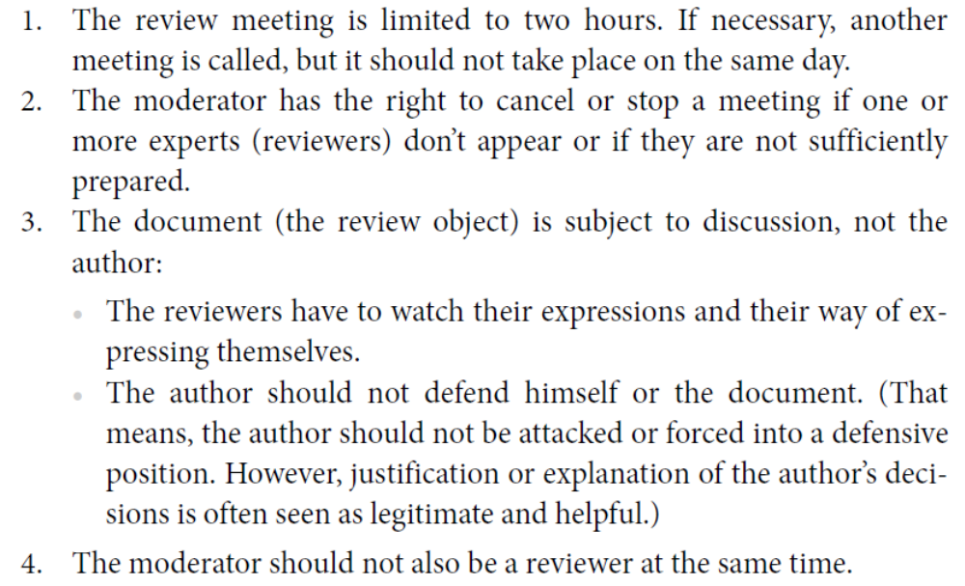
Chapter 4 Static Test

Slide 11
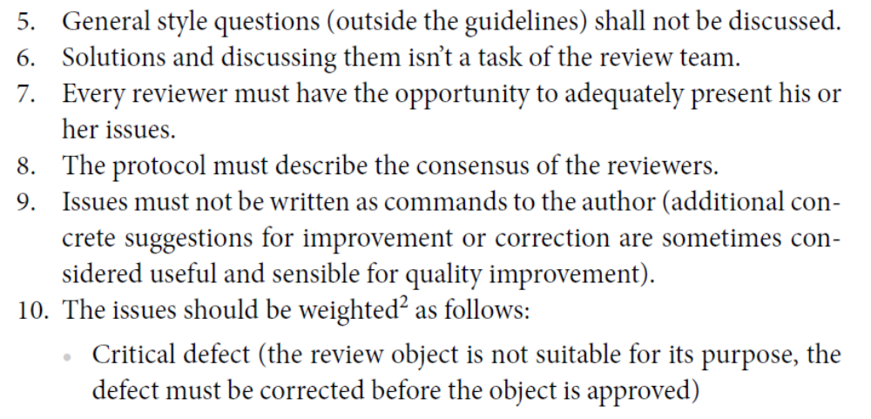
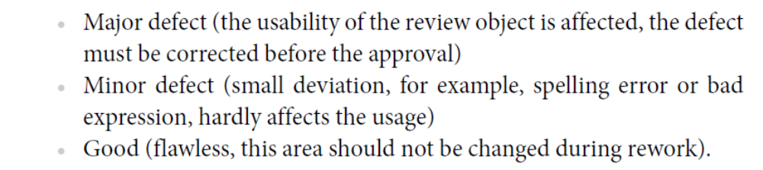
Chapter 4 Static Test

Slide 12
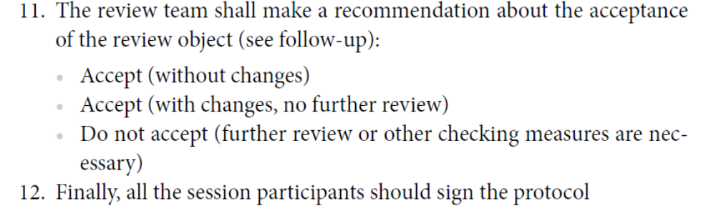
Chapter 4 Static Test
The protocol contains a list of the issues/findings that were discussed during the meeting. An additional review summary report should collect all important data about the review itself, i.e., the review object, the people involved, their roles (see section 4.1.4), a short summary of the most important issues, and the result of the review with the recommendation of the reviewers. In a more formal review, the fulfillment of formal exit criteria may be documented.

Slide 13
Chapter 4 Static Test
Rework:The manager decides whether to follow the recommendation or do something else. A different decision is, however, the sole responsibility of the manager. Usually, the author will eliminate the defects on the basis of the review results and rework the document. More formal reviews additionally require updating the defect status of every single found defect.
Follow-Up:The proper correction of defects must be followed up, usually by the manager,moderator, or someone especially assigned this responsibility;If the result of the first review was not acceptable, another review should be scheduled;The review meetings and their results should then be thoroughly evaluated to improve the review process, to adapt the used guidelines and checklists to the specific conditions, and to keep them up-

Slide 14
Chapter 4 Static Test
to-date. To achieve this, it is necessary to collect and evaluate measurement data;Defect types point to deficiencies in the software development process or lack of technical knowledge of the people involved;Such defect types should be included in the checklists. Training must compensate for lack of technical knowledge;For more formal reviews, the final activity is checking the exit criteria.If they are met, the review is finished. Otherwise, it must be determined whether rework can be done or if the whole review was unsuccessful.
4.1.4 Roles and Responsibilities
The manager selects the objects to be reviewed, assigns the necessary resources, and selects the review team and should not participate in review meetings.

Slide 15
Chapter 4 Static Test
The moderator is responsible for executing the review. Planning,preparation, execution, rework, and follow-up should be done in such a way that the review objectives are achieved;The moderator is responsible for collecting review data and issuing the review report.
The author is the creator of the document that is the subject of a review and If several people have been involved in the creation, one person should be appointed to be responsible.
The reviewers, sometimes also called inspectors, are several (usually a maximum of five) technical experts that participate in the review meeting after necessary individual preparation.
The recorder (or scribe) shall document the issues

Slide 16
Chapter 4 Static Test
(problems, action items, decisions, and recommendations) found by the review team and Pragmatic reasons may make it meaningful to let the author be recorder.
Possible difficulties:Reviews may fail to achieve their objectives due to several causes:
■ The required persons are not available or do not have the required qualifications or technical skills.
■ Inaccurate estimates during resource planning by management may result in time pressure.
■ If reviews fail due to lack of preparation, this is mostly because the wrong reviewers were chosen.
■ A review can also fail because of missing or insufficient documentation.

Slide 17
Chapter 4 Static Test
■ The review process cannot be successful if there is lack of management support because the necessary resources will not be provided and the results will not be used for process improvement.
4.1.5 Types of Reviews
We can distinguish between the following review types:
walkthrough（a manual, informal review，usually for code）
inspection（the most formal review，checklist.....）
technical review（the focus is compliance of the document with the specification, intended purpose, and standards）
informal review. ( a light version of a review. it more or less follows the general procedure for reviews)

Slide 18
Chapter 4 Static Test
In the descriptions, the focus is on the main differences between the particular review type and the basic review process (see section 4.1.3).
A cooperative collaboration between the people involved in software development can be considered beneficial to quality. If people examine each other’s work results, defects and ambiguities can be revealed. From this point of view, pair programming, as suggested in Extreme Programming, can be regarded as a permanent “two-person-review” .

Slide 19
Chapter 4 Static Test
With distributed project teams, it might be hard to organize review meetings. These days, reviews can be in the form of structured discussion by Internet, videoconferencing, telephone conference calls, etc.
4.2 Static Analysis
The objective of static analysis is, as with reviews, to reveal defects or defect-prone parts in a document. However, in static analysis, tools do the analysis.
The term static analysis points to the fact that this form of checking does not involve an execution of the checked objects (of a program). An additional objective is to derive measurements, or metrics, in order to measure and prove the quality of the object.

Slide 20
Chapter 4 Static Test
The document to be analyzed must follow a certain formal structure in order to be checked by a tool. Static analysis makes sense only with the support of tools. Formal documents can note, for example, the technical requirements, the software architecture, or the software design. An example is the modeling of class diagrams in UML. Generated outputs in HTML or XML can also be subjected to tool-supported static analysis. Unfortunately, in practice, the program code is often the one and only formal document in software development that can be subjected to static analysis.
Analysis tools often produce a long list of warnings and comments.
All compilers carry out a static analysis of the program text.

Slide 21
Chapter 4 Static Test
The following defects and dangerous constructions can be detected by static analysis:
■ Syntax violations
■ Deviations from conventions and standards
■ Control flow anomalies
■ Data flow anomalies
Static analysis can be used to detect security problems. Many security holes occur because certain error-prone program constructs are used or necessary checks are not done. Examples are lack of buffer overflow protection and failing to check that input data may be out of bounds.
4.2.1 The Compiler as a Static Analysis Tool
Violation of the programming language syntax is detected by static analysis and reported as a fault or warning. Many

Slide 22
Chapter 4 Static Test
compilers also generate further information and perform other checks:
■ Generating a cross-reference list of the different program elements(e.g., variables, functions)
■ Checking for correct data type usage by data and variables in programming languages with strict typing
■ Detecting undeclared variables
■ Detecting code that is not reachable (so-called dead code)
■ Detecting overflow or underflow of field boundaries(with static addressing)
■ Checking interface consistency
■ Detecting the use of all labels as jump start or jump target

Slide 23
Chapter 4 Static Test
The information is usually provided in the form of lists. A result reported as “suspicious” by the tool is not always a fault.
4.2.2 Examination of Compliance to Conventions
and Standards
Compliance to conventions and standards can also be checked with tools.
4.2.3 Execution of Data Flow Analysis
Data flow analysis is another means to reveal defects. Here, the usage of data on paths through the program code is checked. It is not always possible to decide if an issue is a defect. Instead, we speak of anomalies, or data flow anomalies;An anomaly may be flagged as a risk.
An example of a data flow anomaly is code that reads

Slide 24
Chapter 4 Static Test
(uses) variables without previous initialization or code that doesn’t use the value of a variable at all.
The following three types of usage or states of variables are distinguished(The analysis checks the usage of every single variable):
■ Defined (d): The variable is assigned a value.
■ Referenced (r): The value of the variable is read and/or used.
■ Undefined (u): The variable has no defined value.
We can distinguish three types of data flow anomalies:
■ ur-anomaly: An undefined value (u) of a variable is read on a program path (r).(the variable Help)
■ du-anomaly: The variable is assigned a value (d) that becomes invalid/undefined (u) without having been used in

Slide 25
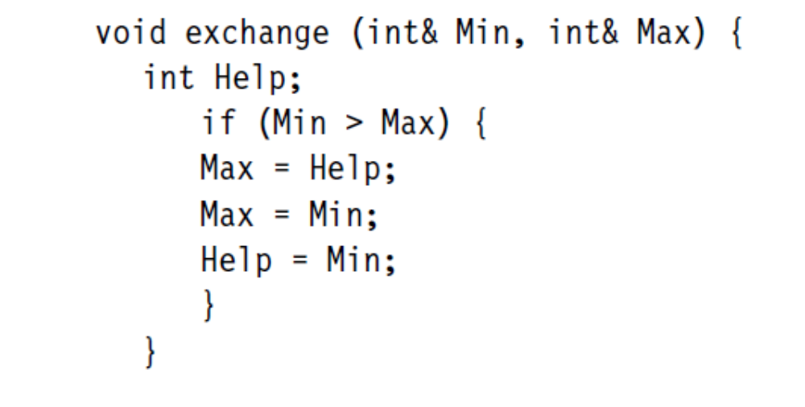
Chapter 4 Static Test
the meantime.(the variable Help)
■ dd-anomaly: The variable receives a value for the second time (d) and the first value had not been used (d).(the variable Max)
We will use the following example (in C++) to explain the different anomalies.

Slide 26
Chapter 4 Static Test
4.2.4 Execution of Control Flow Analysis
In figure 4-1, a program structure is represented as a control flow graph. In this directed graph, the statements of the program are represented with nodes.
Sequences of statements are also represented with a single node because inside the sequence there can be no change in the course of program execution. If the first statement of the sequence is executed, the others are also executed.
Changes in the course of program execution are made by decision statement(If, Case).
Due to the clarity of the control flow graph, the sequences through the program can easily be understood and possible anomalies can be detected.These anomalies

Slide 27
Chapter 4 Static Test
could be jumps out of a loop body or a program structure that has several exits.
It is assumed that the graph is not generated manually but that it is generated by a tool that guarantees an exact mapping of the program text to the graph.
If parts of the graph or the whole graph are very complex and the relations are not understandable, then the program text should be revised, because complex sequence structures often bear a great risk of being wrong.
4.2.5 Determining Metrics
In addition to the previously mentioned analyses, static analysis tools provide measurement values. Quality characteristics can be measured with measurement values, or metrics. The measured values must be checked.

Slide 28
Chapter 4 Static Test
to see if they meet the specified requirements [ISO 9126].
The definition of metrics for certain characteristics of software is based on the intent to gain a quantitative measure of software whose nature is abstract.
In the following, we’ll take a closer look at a certain metric: the cyclomatic number (McCabe number). The cyclomatic number measures the structural complexity of program code. The basis of this calculation is the control flow graph.
For a control flow graph (G) of a program or a program part, the cyclomatic number can be computed like this(The original formula is v(G) = e - n + 2p, where p is the number of connected program parts. We use p=1 because there is only one part that is analyzed.)

Slide 29
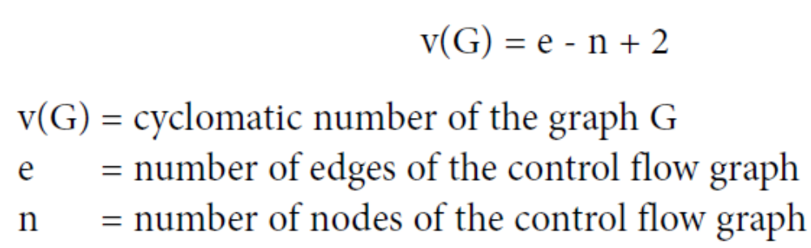
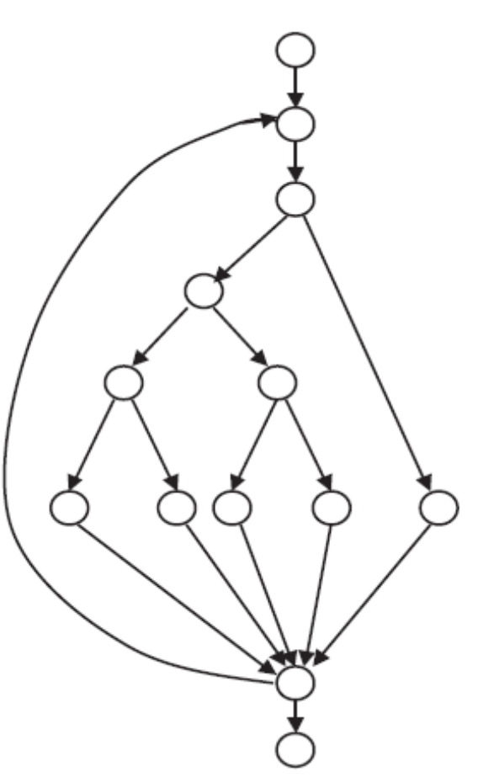
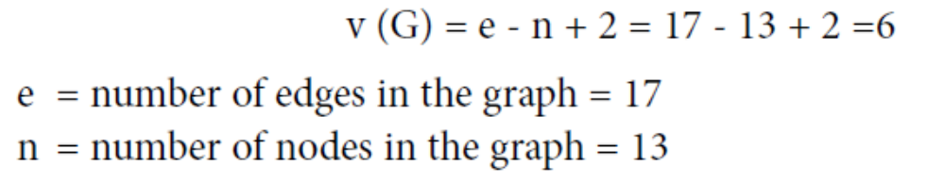

Chapter 4 Static Test
A program part is represented by the graph shown in figure 4-1. It is a function that can be called. Thus, the cyclomatic number can be calculated like this:

Slide 30
Chapter 4 Static Test
The value of 6 is, according to McCabe, acceptable and in the middle of the range.He assumes that a value higher than 10 cannot be tolerated and rework of the program code has to take place.
The cyclomatic number can be used to estimate the testability and the maintainability of a particular program part. The cyclomatic number specifies the number of independent paths in the program part(This means all complete linearly independent paths). If 100% branch coverage (see section 5.2.2) is intended, then all these independent paths of the control flow graph have to be executed at least once. Therefore, the cyclomatic number provides important information concerning the volume of the test.
Understanding a program is essential for its maintenance.

Slide 31
Chapter 4 Static Test
The higher the value of the cyclomatic number, the more difficult it is to understand the flow in a certain program part.
The cyclomatic number has been very much discussed since its publication. One of its drawbacks is that the complexity of the conditions, which lead to the selection of the control flow, is not taken into account. It does not matter for the calculation of the cyclomatic number whether a condition consists of several partial atomic conditions with logical operators or is a single condition. Many extensions and adaptations have been published concerning this.

